Slide 1

Store
Management
System
Software Revealing
Presented By:
Team #Hash
Notes:
To use this title animation slide with a new image simply 1) move the top semi-transparent shape to the side, 2) delete placeholder image, 3) click on the picture icon to add a new picture, 4) Move semi-transparent shape back to original position, 5) Update text on slide.

Slide 2

INTRODUCTION
This Software will allow you keep your store’s sells information.
You can search them, update them & delete them.
You can provide your customer correct information just in time as they want.
Store Management System

Slide 3
INTRODUCTION (Cont…
Purpose of Making
Keeping records in your typical record books manually takes too much time & creates a lot of complexity in your business.
It can be damaged or can be lost. It can hamper your business privacy to your rival often.
A server based software like Store Management System can save your time.
You can easily access your database server by user login & can protect your business privacy.
Store Management System

Slide 4





INTRODUCTION (Cont…
Store Management System
Keeping records in server is much easier!!!
4

Slide 5




INTRODUCTION (Cont…
Tools Used
Store Management System

Slide 6
E-R Diagram
Category
Product Name
Unit Price
Store Management System
Product ID
Product
Stock
Authenticate
Username
Password

Slide 7
Flow Chart
Store Management System

Slide 8
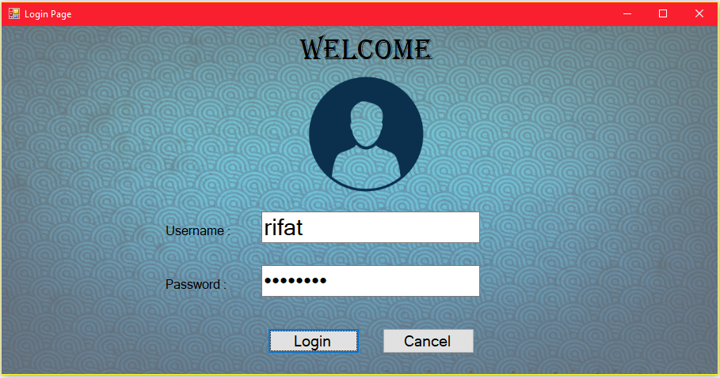
Screenshots
Store Management System
Login Page

Slide 9
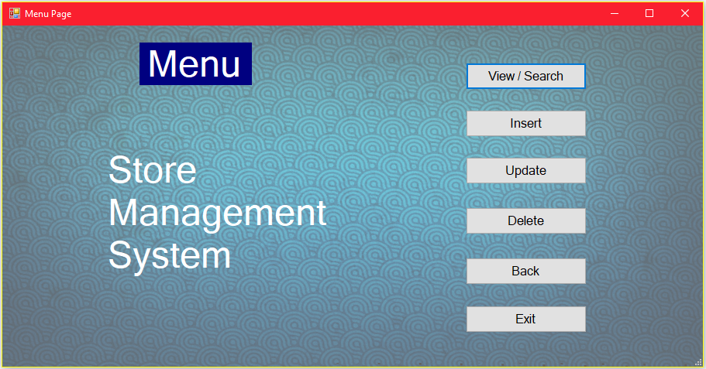
Screenshots (Cont…
Store Management System
Menu Page

Slide 10
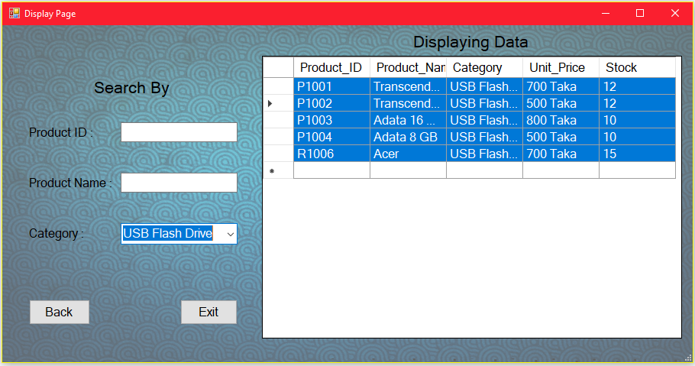
Screenshots (Cont…
Store Management System
Searching Data by Category

Slide 11
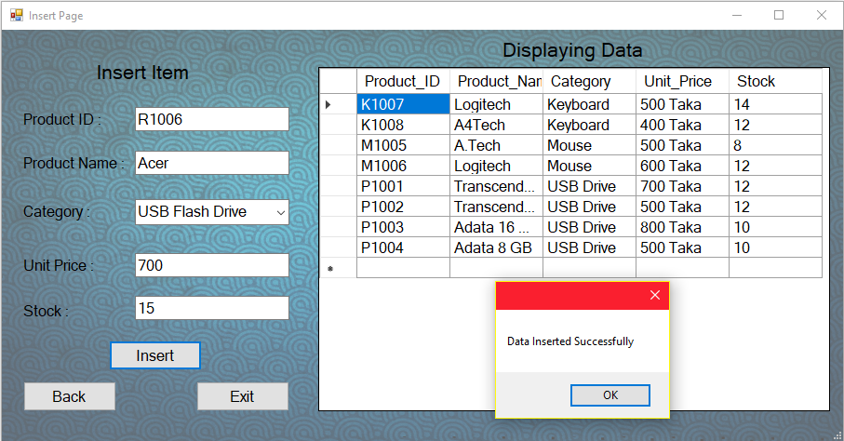
Screenshots (Cont…
Store Management System
Insert Item

Slide 12
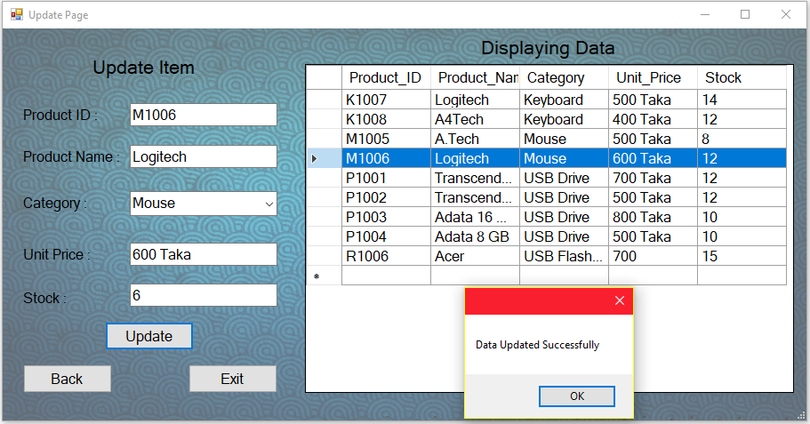
Screenshots (Cont…
Store Management System
Updating Data

Slide 13
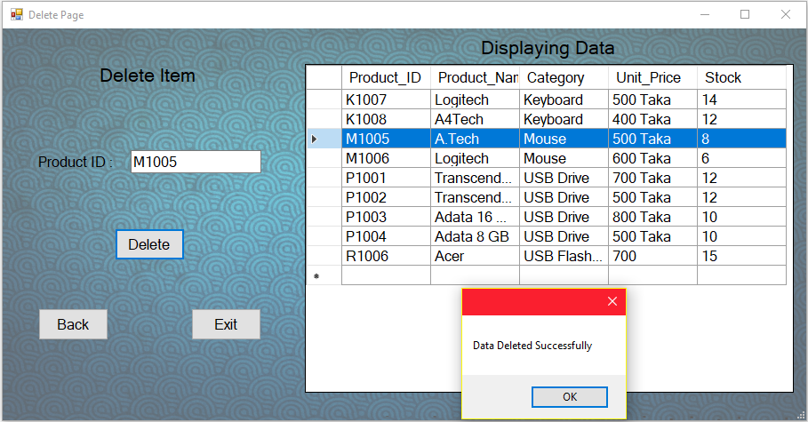
Screenshots (Cont…
Store Management System
Delete Data

Slide 14
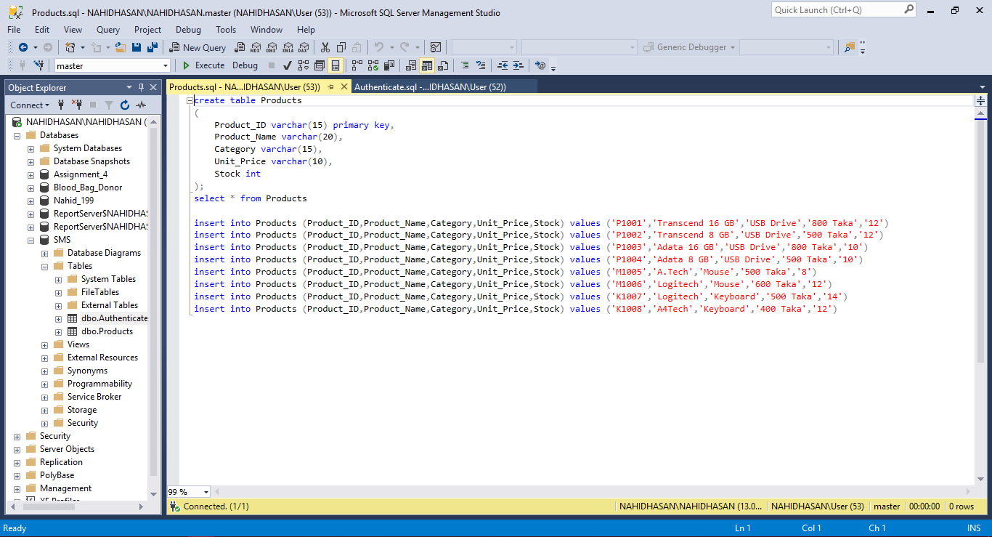
Screenshots (Cont…
Store Management System
Code in SQL

Slide 15
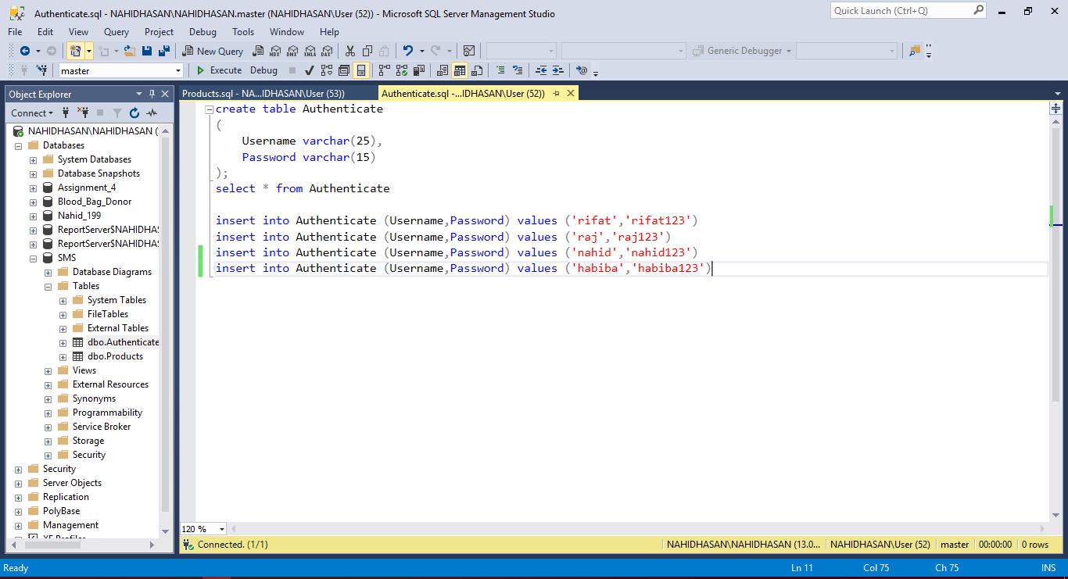
Screenshots (Cont…
Store Management System
Code in SQL

Slide 16


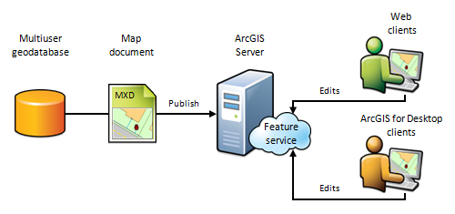

Future Plans
It is worth saying that we have a big dream for our project. And we are on our way. Our future plans are:
Store Management System
Improve User Interface
More User Friendly
Add Many More Features
Remove Minor Bugs

Slide 17



That’s All
T H A N K
Y O U
☺
References:

